Slide 1


PREDICTION OF
ROCK PROPERTIES
Application of Machine Learning in predicting Mechanical Properties of Rocks

Slide 2




ROCK PROPERTIES
Density
Porosity
P-wave Velocity
Point Load Strength Index
Uniaxial Compressive Strength(UCS)
Elasticity
Brazilian Tensile Strength

Slide 3
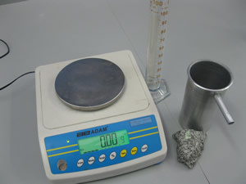
DENSITY
Density of the Rock= Mass/Volume
How is it Calculated:
Measuring Mass:
Requires a Balance Scale
Measuring Volume:
Can be found by Submersion

Slide 4
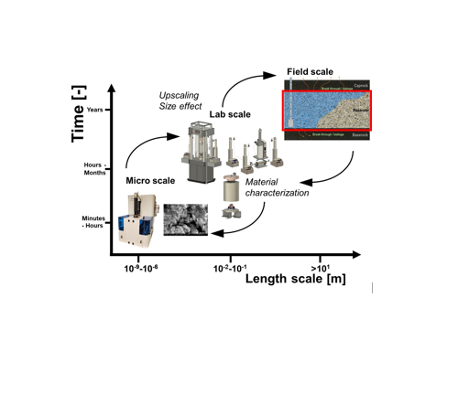
POROSITY
Porosity is a measure of the open space or voids within a rock or soil
porosity= (%)=(Volume of Voids/ Total Rock Volume)×100
How is it Calculated:
Mercury Intrusion Porosimetry:
Mercury intrusion porosimetry is a laboratory technique used to measure the distribution of pore sizes in a rock sample. The method involves immersing the rock sample in mercury and applying pressure, which forces the mercury into the open pores. The intrusion volume at different pressure levels is then measured. By analyzing the relationship between pressure and intrusion volume, scientists can determine the size and distribution of pores, providing insights into the rock's porosity characteristics

Slide 5
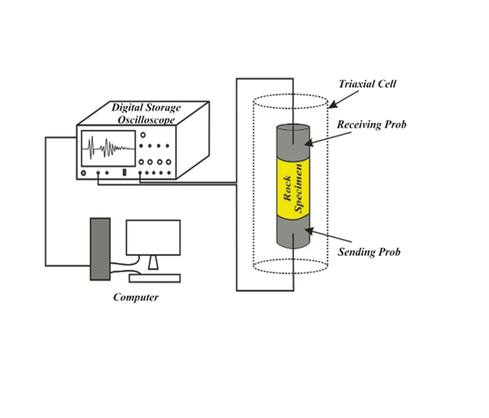
P-WAVE VELOCITY
It is the speed at which compressional or primary seismic waves travel through a material, such as rocks
P-wave velocity (Vp=d/t)​
How is it Calculated: P-wave velocity in rock is determined by introducing P-waves into a rock sample using a seismic source, measuring the travel time with seismometers

Slide 6
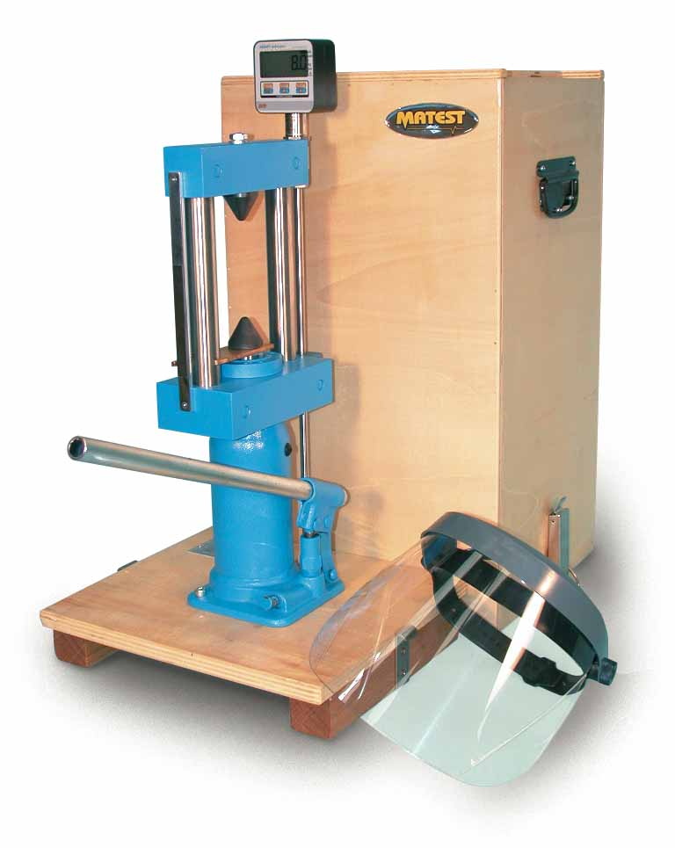
POINT LOAD INDEX
The Point Load Strength Index (PLSI) is a measure used in geotechnical and rock mechanics to assess the strength of rock or geological formations.
P load=2P/d
How is it Calculated:
The PLSI test involves applying a concentrated load to a rock specimen using a pointed tip. The load is applied parallel to the bedding plane or foliation of the rock. The test measures the point load strength, which is the force required to fracture the rock divided by the cross-sectional area of the rock specimen at the point of loading.

Slide 7
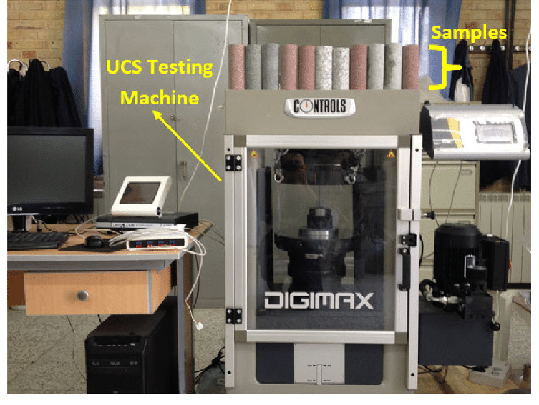
UCS
UNIAXIAL COMPRESSIVE STRENGTH
It represents the maximum stress that a cylindrical or cubical rock sample can sustain under a uniaxial (vertical) compressive load without failing
UCS = Maximum Axial Load/Cross-sectional Area of the Rock Specimen
How is it Calculated:
The UCS test involves preparing a cylindrical or cubical rock specimen with standardized dimensions. The specimen is then loaded axially in a hydraulic testing machine until failure occurs. The applied load and the dimensions of the specimen are used to calculate the UCS.

Slide 8
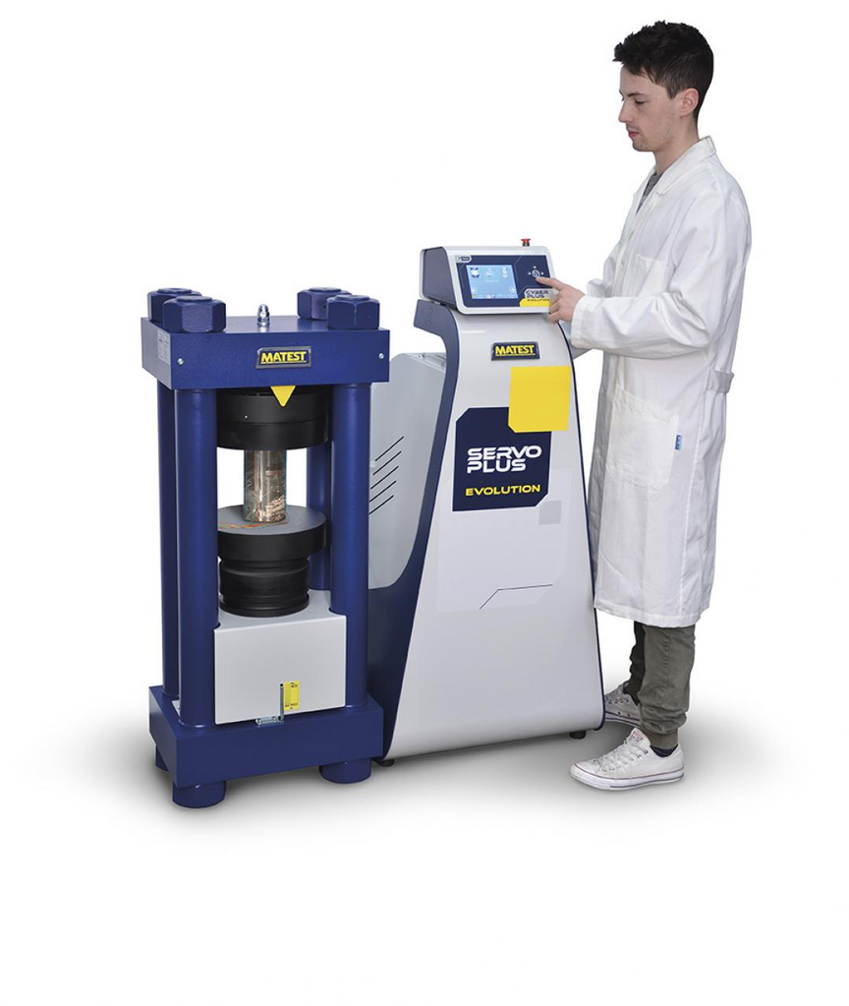
ELASTICITY
Elasticity, specifically Young's Modulus (E), is a measure of the stiffness or rigidity of a rock. It indicates the rock's ability to deform under stress and return to its original shape once the stress is removed.
E = stress applied to the rock/ resulting strain (deformation)
How is it Calculated:
, the stress is usually uniaxial compressive stress, and strain is the resulting axial strain.

Slide 9
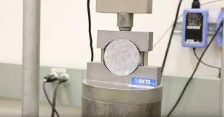
BRAZILIAN TENSILE STRENGTH
The Brazilian Test is valuable for estimating the tensile strength of rocks, which is an essential parameter in understanding the overall mechanical behavior of rocks
T_b = 2p/pi D
How is it Calculated:
Brazilian Test, is a method used to determine the tensile strength of rocks. In this test, a cylindrical rock specimen is subjected to diametral loading, causing the rock to fail in tension along a diameter perpendicular to the loading direction.

Slide 10

SVM
WHY MACHINE
LEARNING
BPNN
Data-driven Predictions
Multivariable Analysis
Improved Accuracy
Pattern Recognition
Uncertainty Estimation
Cost Reduction
Real-time Monitoring
Time effectiveness
RF
Linear Regression
KNN

Slide 11

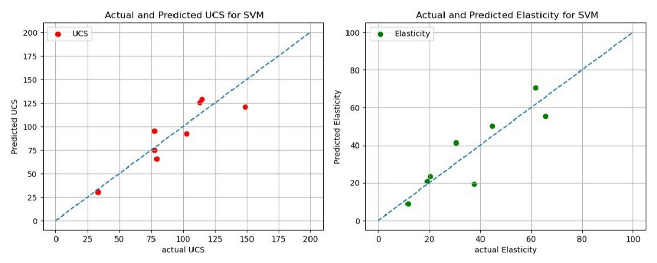
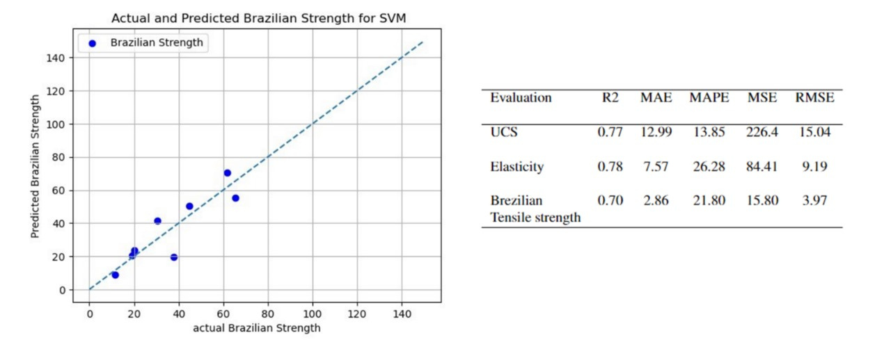
RESULTS
SVM

Slide 12
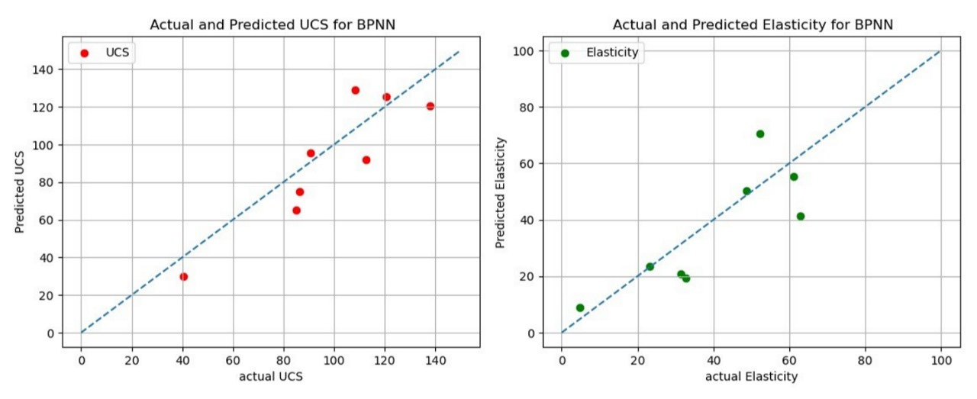
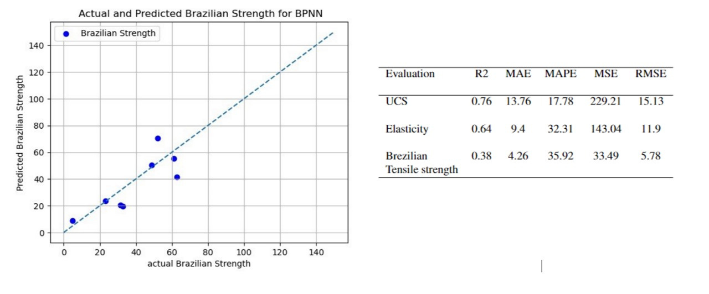
RESULTS
BPNN

Slide 13
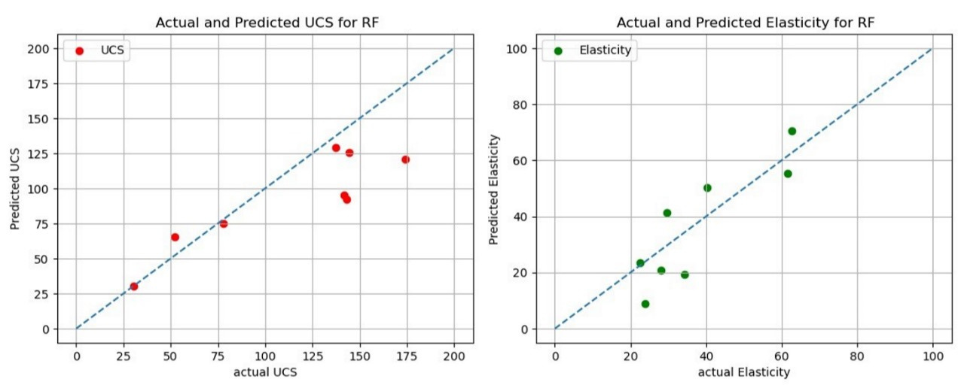
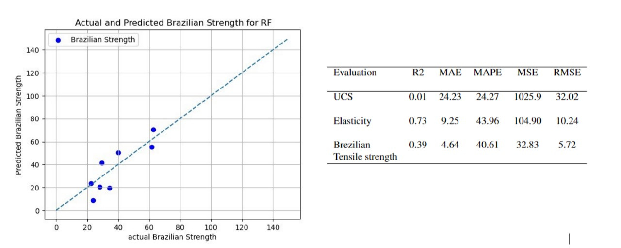
RESULTS
RF(RANDOM FORESTS)

Slide 14
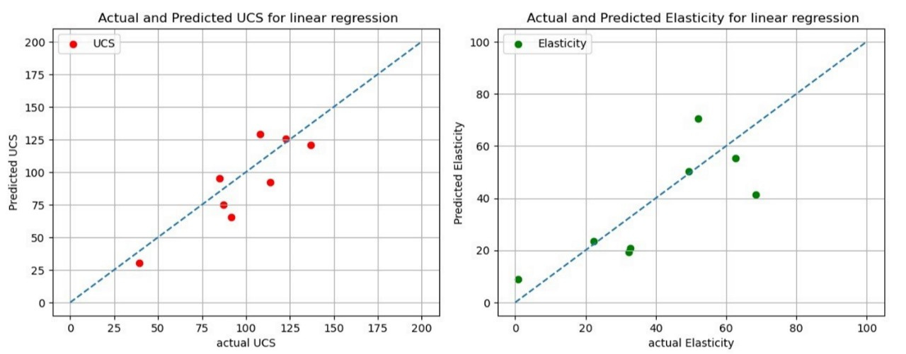
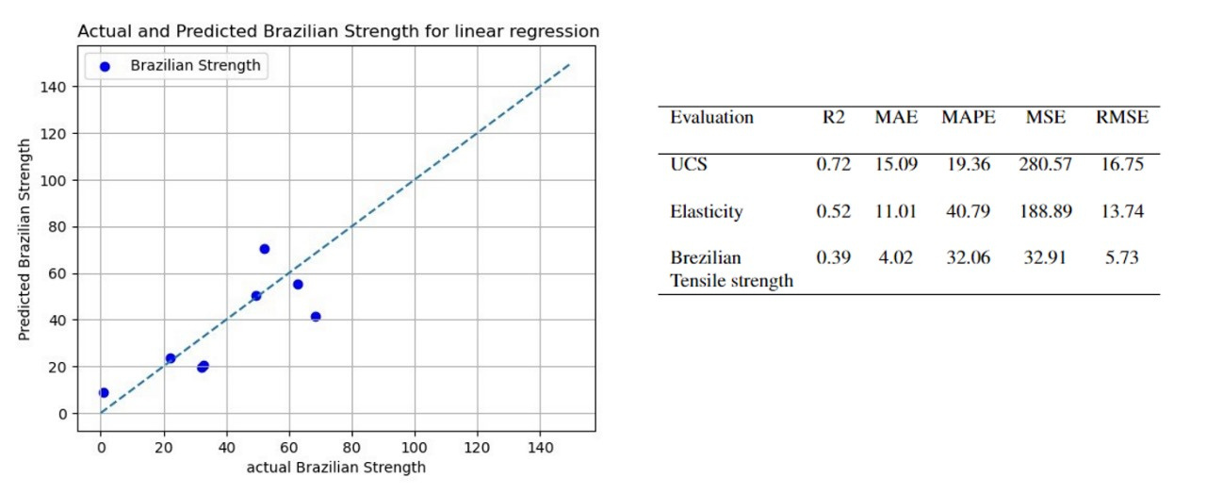
RESULTS
LINEAR REGRESSION

Slide 15
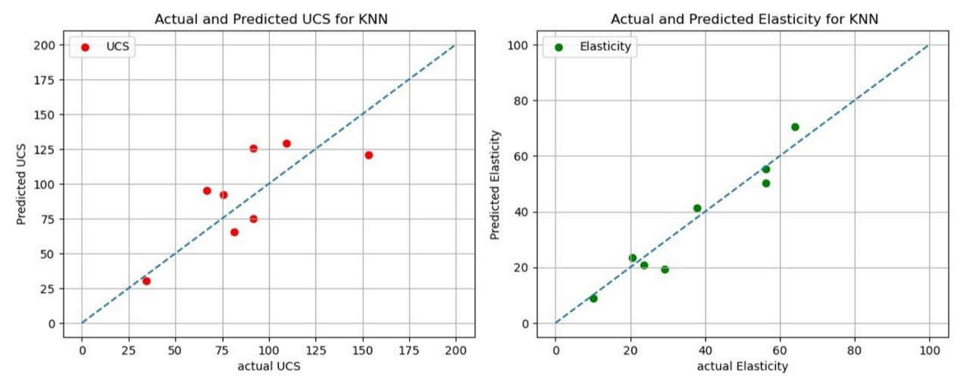
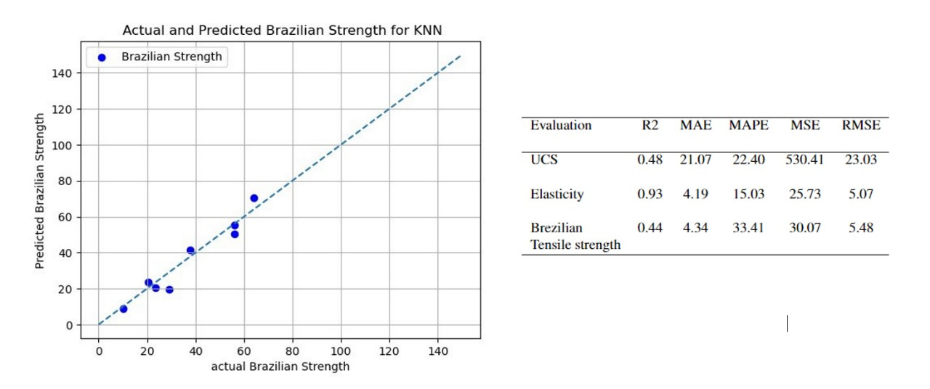
RESULTS
KNN

Slide 16
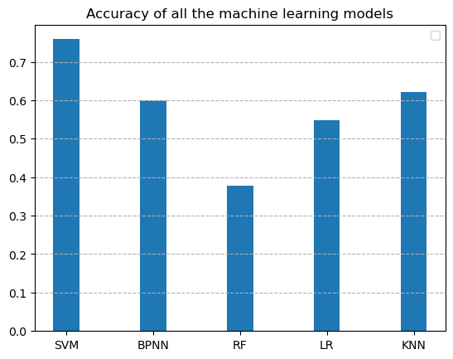
OVERALL
ACCURACY
Our results demonstrated that the SVM-based model
shows a better performance than all the other models

Slide 17

THANK YOU
Chapati Anusha, Chitturi Laasya Priya
112101010@smail.iitpkd.ac.in
112101012@smail.iitpkd.ac.in

